Slide 1
Modern cloud apps
Speaker name

Slide 2
Abstract and learning objectives
In the whiteboard design session, you will work in groups to design a solution to modernize CSLA's e-commerce and back-end services while maintaining existing PCI compliance. To ensure compliance, you will ensure data privacy and protection across all aspects of the system, in transit and at rest. The goal is to use Azure PaaS services for the public-facing and back-end websites, while providing a way for the on-premises components to securely communicate with these services. You will also design fault-tolerance and a regional failover plan of the Azure components.
By the end of this whiteboard design session, you will have a better understanding of how to modernize a legacy web app by retargeting it for the cloud, taking advantage of the many services Azure provides to enhance functionality and secure your solution's components by following best practices for PCI compliance and security.
Notes:
This is an introduction to the Cloud Workshop at a high level. Later we’ll get into customer objections, requirements, etc… but we want to ground the participants on the business outcomes we’re going after for the day.

Slide 3
Step 1: Review the customer case study
Outcome
Analyze your customer needs.
Timeframe
15 minutes

Slide 4
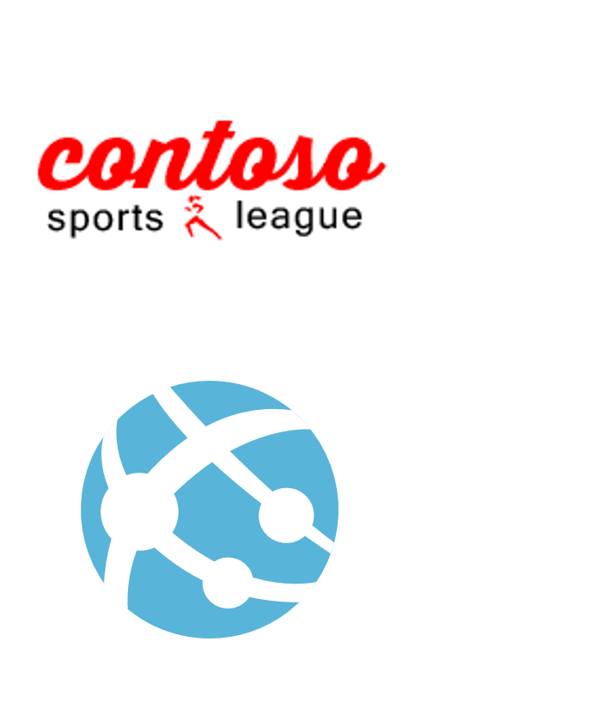
Customer situation
Contoso Sports League Association is one of the largest sports franchises
Run a highly successful e-commerce website
Backend website supports call center
Need to be PCI DSS Level 1 compliant
Notes:
The Contoso Sports League Association (CSLA) is one of the largest sports franchises.
They run a highly successful e-commerce website that sells merchandise to their legions of sports fans.
This website is built using ASP.NET Core
Currently hosted in a co-lo.
They also have a backend website that supports their call center. Call center employees use this admin website to view customer orders.
They accept payment by credit card, and owing to their high annual volume (in the tens of millions, processing about 50K per day) of transactions, need to ensure that they are PCI DSS Level 1 compliant.
Their website hosts the shopping cart and checkout process
They defer the credit card authorization and capture responsibilities of the credit card processing to a third-party payment gateway.
This payment gateway provides a web API that is invoked over TLS from Contoso server side logic.
The call includes the credit card holder data (name, number, etc.) and returns a status indicating a success or failure in authorizing and capturing payment against the credit card.

Slide 5
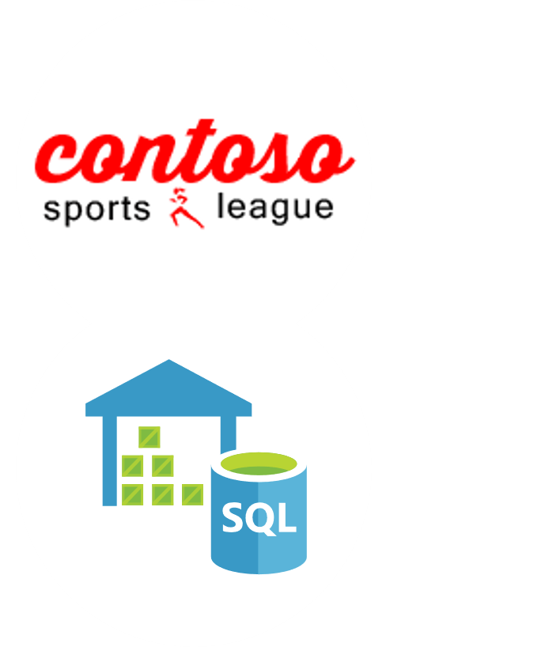
Customer situation - 2
Looking to augment On-Line Transaction Processing (OLTP) database with a data warehouse for analytics
Manages order fulfillment process
Inventory management system used to perform inventory lookup
Business hours occur during a 12-hour window, spanning East to West coast
Notes:
When a customer completes a purchase, that customer is emailed a receipt. This email contains the receipt in the body of the email, as well as a PDF attachment.
They have about 10 GB of PDFs that are currently stored on disks available to the web server via a network share (they don’t expect their receipt storage needs to double in less than 10 years).
They currently store their order, customer, and profile data in SQL Server 2014 and are looking to augment their OLTP database with a data warehouse for analytics (updated nightly).
CSLA manages the order fulfillment process.
They store the order details in their SQL database,
Send a message for each order to their inventory management system running the warehouse to perform inventory lookup.
CSLA experiences a roughly 12-hour window that spans East to West coast business hours, during which they get most of their orders.
This inventory lookup rarely takes more than a few hours and never more than a day.

Slide 6

Customer needs
Move infrastructure to PaaS solutions
Maintain PCI compliance
Ensure data privacy and protection
Provide better management of usernames and passwords
Notes:
Manage their server infrastructure, which is becoming a real challenge. Contoso is interested in understanding more about PaaS solutions.
Maintain existing PCI compliance.
Assure data privacy and protection across all aspects of the system; in transit and at rest.
Make architectural decisions that help to minimize engineering around infrastructure in favor of those that deliver core business value.
Ensure that they retain their core functionality, even if the way it is accomplished under the covers might change.
Provide a better solution for the management of usernames and passwords.

Slide 7
Customer needs - 2
Send SMS notifications
Scale API independently of website
Provide failover mechanism
Data warehouse for analytics
Automated deployments of application code
Notes:
Desire an “easy” solution for sending SMS notifications to customers when an order is ready.
Want to be able to scale their offers’ API independently of the website.
Provide a failover mechanism in the event of a regional outage.
A data warehouse for analyzing their transaction history.
Automated deployments of their application code

Slide 8


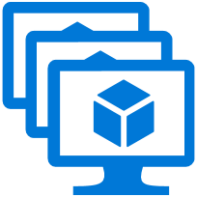
Customer objections
How can Azure Trust Center help with PCI compliance?
Can solution scale to meet customer demand, and allow secure access by call center and warehouse?
Can we conduct penetration testing in Azure?
Can we audit the Azure data center?
Notes:
It is not clear to us from the Azure Trust Center just how Azure helps our solution become PCI compliant.
Can we provide a solution that scales to meet our public demand, but is also secure for use by our call center and warehouse?
Our PCI compliance requires us to have a quarterly audit and to conduct occasional penetration tests. Is this supported by Azure?
Can we audit the Azure data center?

Slide 9
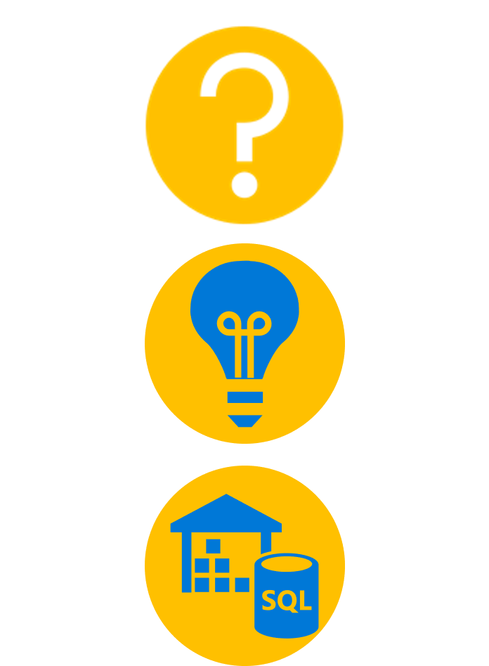
Customer objections - 2
Can we leverage CloudTest in Azure?
What options are available for performance monitoring?
What is the impact of pausing Azure Data Warehouse on our data?
Can’t we use Azure SQL Database for our data warehouse?
Notes:
In the past, we have relied on SOASTA CloudTest to design and execute at scale our web load tests. In moving to Azure, are we still able to leverage CloudTest?
Our previous infrastructure did not have great performance monitoring of our websites, what options would you recommend we investigate that would work with our Web Apps in Azure?
We’ve heard that Azure’s data warehouse can be paused? Does that mean we must store all our data in Azure Storage first before we can pause the instances and risk losing our data?
We know it's possible to use Azure SQL Database as our data warehouse. What should we consider when deciding between this and Azure Synapse Analytics?

Slide 10

Common scenarios
Notes:
This is a diagram of a common architecture for this type of scenario, from which you can draw inspiration. You will find this diagram within the Whiteboard Design Session Student Guide.

Slide 11
Step 2: Design the solution
Outcome
Design a solution and prepare to present the solution to the target customer audience in a 15-minute chalk-talk format.
Timeframe
60 minutes
Business needs (10 minutes) | Respond to questions outlined in your guide and list the answers on a flipchart.
Design (35 minutes) | Design a solution for as many of the stated requirements as time allows. Show the solution on a flipchart.
Prepare (15 minutes) | Identify any customer needs that are not addressed with the proposed solution. Identify the benefits of your solution. Determine how you will respond to the customer’s objections. Prepare for a 10-minute presentation to the customer.

Slide 12
Step 3: Present the solution
Outcome
Present a solution to the target customer in a 15-minute chalk-talk format
Timeframe
30 minutes (15 minutes for each team to present and receive feedback)
Directions
Pair with another table.
One table is the Microsoft team and the other table is the customer.
The Microsoft team presents their proposed solution to the customer.
The customer asks one of the objections from the list of objections in the case study.
The Microsoft team responds to the objection.
The customer team gives feedback to the Microsoft team.

Slide 13
Wrap-up
Outcome
Identify the preferred solution for the case study.
Identify solutions designed by other teams.
Timeframe
15 minutes

Slide 14

Preferred target audience
Miles Strom, CEO of Contoso Sports League Association
Primary audience is business and technology decision makers
Usually talk to Infrastructure Managers who report to the CIO, or to application sponsors (like a VP LOB, CMO) or to those that represent the Business Unit IT or developers that report to application sponsors
Notes:
Miles Strom, CEO of Contoso Sports League Association
The primary audience is business decision makers and technology decision makers.
Usually we talk to the Infrastructure Managers who report to the CIO, or to application sponsors (like a VP LOB, CMO) or to those that represent the Business Unit IT or developers that report to application sponsors.

Slide 15
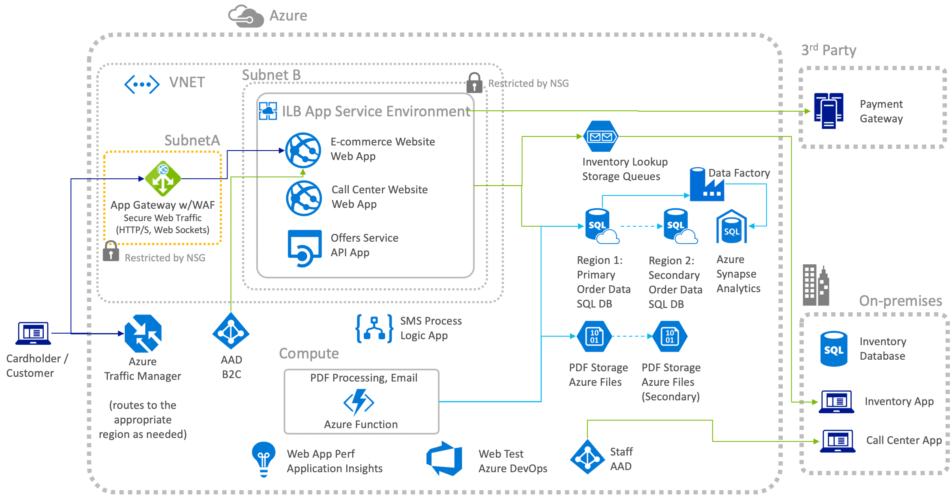
Preferred solution
Notes:
This preferred solution is just one of many viable options
From a high-level:
Web Apps hosting the e-commerce and call center websites,
API Apps hosting web services
Logic Apps hosting integration with SMS
Azure Traffic Manager is used for routing to the appropriate region for high availability
The Web and API Apps can be hosted within an Internal Load Balanced (ILB) App Service Environment (ASE) that enables them to take advantage of Network Security Groups to lock down inbound and outbound communication to the App Services it hosts
Web Application Firewall (WAF) provided by an Azure App Gateway is hosted in its own subnet and NSGs. Internet traffic flows through the WAF to the e-commerce website that’s hosted within the ASE, which only allows inbound traffic from the WAF.
When customers visit the website, they are presented featured products on offer whose data comes from the Offers Service REST API hosted within an API App.
Orders come in from customers via the publicly accessible endpoint of the e-commerce website.
Credit card is validated as a part of the checkout process by making a call to a third-party payment gateway.
Once authorized and payment is captured, the order data is stored in the orders database on SQL DB and the inventory lookup message is sent to the Inventory Lookup queue.
An Azure Function is used for creating the PDF receipts for customer purchases.
Customers are notified via SMS as their order is processed, via a process running in a Logic App that integrates the SQL DB with a third-party solution for sending SMS text messages.
Inventory lookup requests are queued from the e-commerce website to the queue in Azure Storage queues. The on-premises inventory app reads from this queue to kick off its internal lookup processes and writes the status back to the orders database.
Call center operators access the call center website which, owing to the NSGs configured, is only available across the virtual private network (VPN) connection.

Slide 16
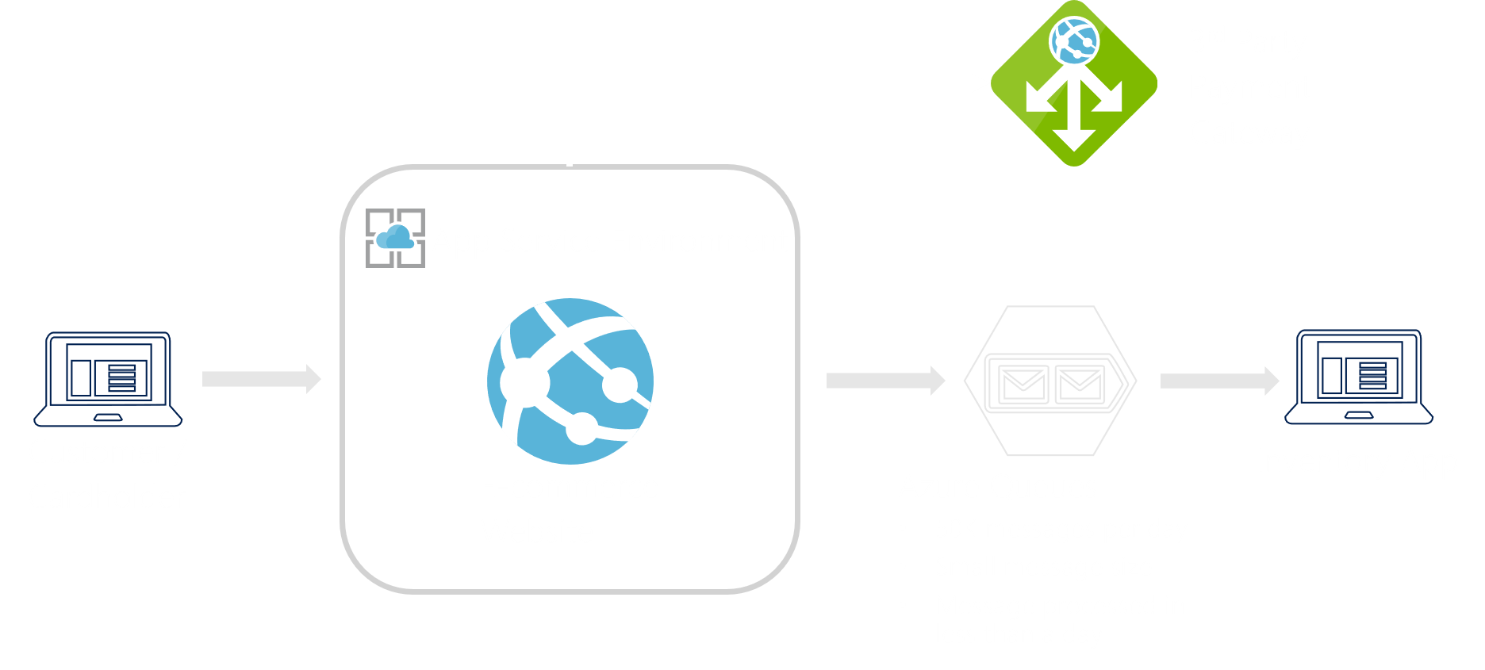
Preferred solution - 2
Order fulfillment
Notes:
How would you recommend CSLA manage the inventory lookup queues? How would you help CSLA decide between Azure Queues and Service Bus? Be sure to consider details implied by SLA’s requirements such as volume, message lifetime and sizing. Explain the details of any computations you make.
No specific asks implying need for Service Bus features
Low volume of 50k per day (Queues supports 2k per second)
Small messages sizes
Messages processed in less than a day
Consider Azure Queues

Slide 17
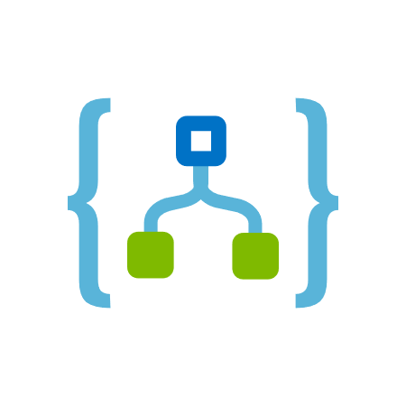
Preferred solution - 3
Notifications
Use Logic App
Frequency trigger executes stored procedure
Twilio connector action to send SMS message
Notes:
How would you recommend CSLA manage notifying customers as their order in the CSLA orders database is processed?
A logic app with:
a frequency trigger to execute a stored procedure at an interval that will identify orders that should receive SMS notifications and update them as processed.
a Twilio Connector could act as the action to perform that sends the SMS message when the frequency trigger executes the stored procedure.

Slide 18

Preferred solution - 4
Offers Service
Migrate to Azure App Service API App
Enable CORS
Consider API Management
Notes:
How would you propose Contoso meet their requirements for the Offers service?
Migrate to Azure App Service API App
What specific configurations would you need to make to support your proposed topology?
Need to enable CORS in:
API App
Web API code
Also consider suggesting future API Management as a feature for Contoso to support partner integrations.
Enable lock down access by requiring a key, apply policy (such as rate limiting requests), and monitor usage by API customer

Slide 19
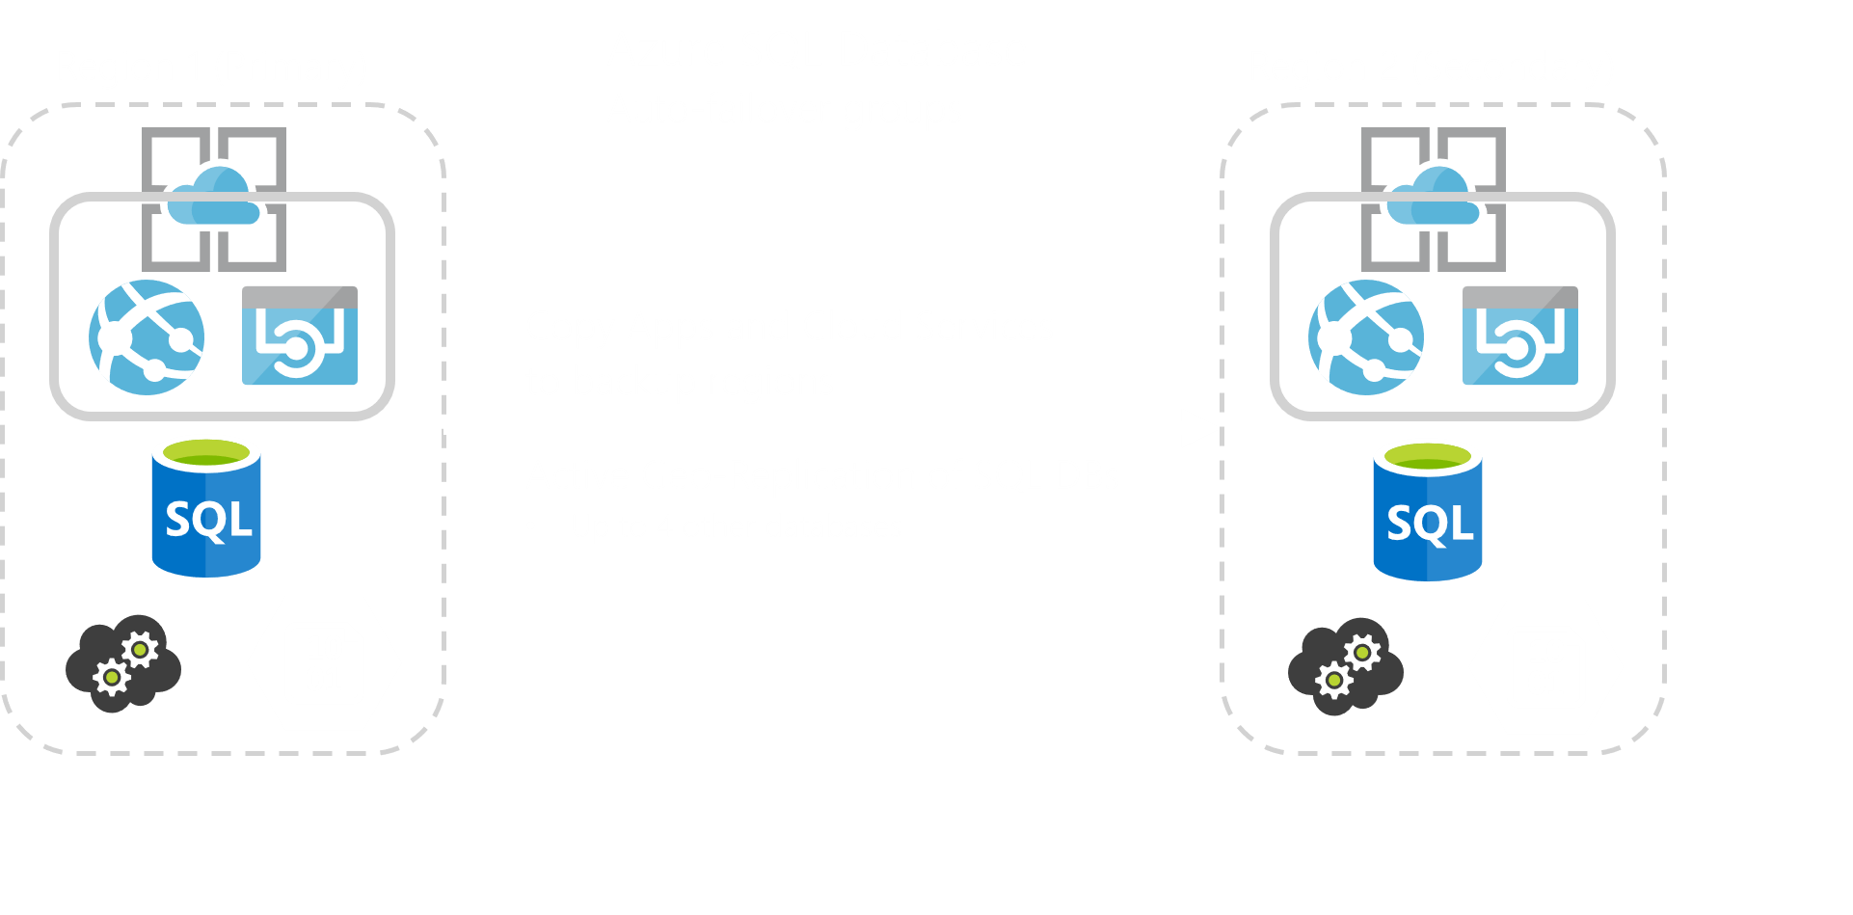
Preferred solution - 5
Geo-resiliency
Notes:
How would you implement high availability for the orders database to guard against regional data center outages?
Use Active Geo-Replication to up to four other databases on different servers in different regions.
Provision the Azure Storage Account with RA-GRS redundancy (matching the regions used by SQL DB).
Deploy copies of the App Services and Cloud Services to the backup regions.
When using auto-failover groups to manage database recovery and any outage that impacts one or several of the databases in the group results in automatic failover.
How long would a failover take and how much data could be lost, in terms of time?
The amount of time a failover takes is the Recovery Time Objective (RTO) The amount of data loss that might transpire due to any replication latency is the Recovery Point Objective (RPO).
For SQL Database on the Premium tier, the RTO is less than 30 seconds and the RPO is less than 5 seconds.
For Azure Storage, the RTO is about 24 hours and the RPO is typically less than 15 minutes (though this has no explicit SLA).
Given the potentially long RTO and RPO for Azure Storage, Contoso should consider using RA-GRS storage and when a failover happens use the RA-GRS for read and a separate storage account for the writing of new files.

Slide 20
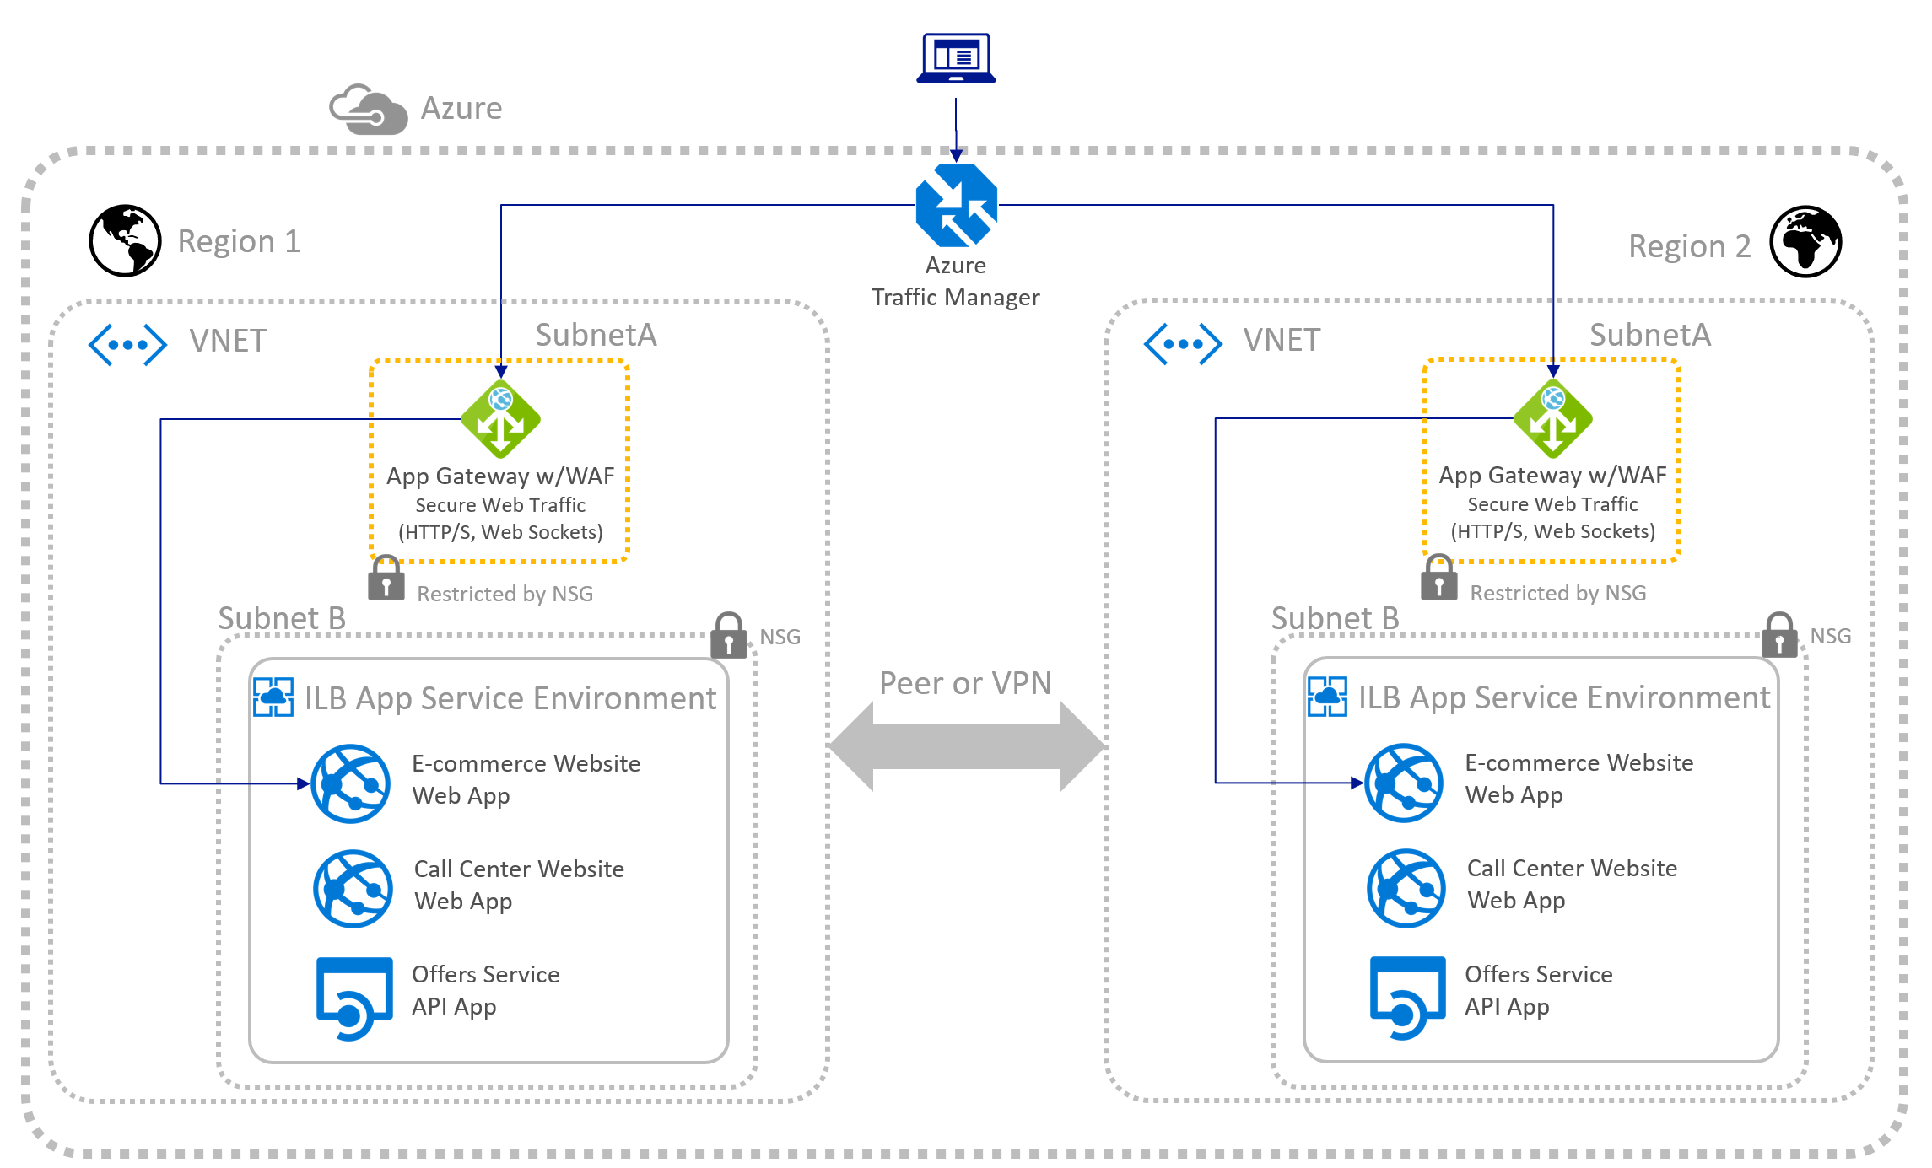
Preferred solution - 6
Geo-resiliency for apps
Notes:
What process would you recommend to the customer to failover in the event of an outage, ensuring their web applications and associated Azure services change over to a secondary region?
Azure Traffic Manager can be used along with health probes to monitor the App Services hosted within each region. Traffic Manager routes all internet traffic to the Application Gateway WAF, which in turn securely connects into the ILB App Service Environment to the e-commerce website. If the health probes indicate a certain number of failures within a region, it automatically starts routing traffic to the secondary region. This topology can also be used for horizontally scaling out apps located within the geo-distributed ASEs, enabling extreme load handling. For geographic redundancy, the application's resources are deployed to Region 1 and 2.

Slide 21
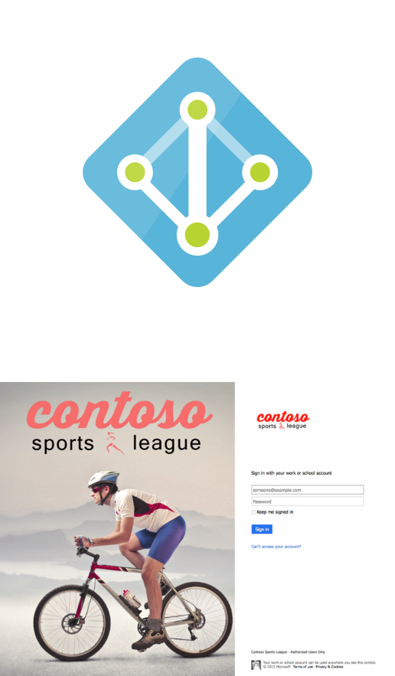
Preferred solution - 7
Access control
Use Azure Active Directory
Customize Branding
AAD Reports
Apply to Call Center Website
Notes:
With respect to managing access to the call center website, explain how you would recommend Contoso implement a solution that meets their requirements.
Leverage Azure Active Directory Basic or Premium for call center staff accounts
Login customization via Customize Branding (requires Premium tier AAD)
Hacker concerns: AAD Reports
Apply to Call Center Website using Web App Authentication/Authorization

Slide 22
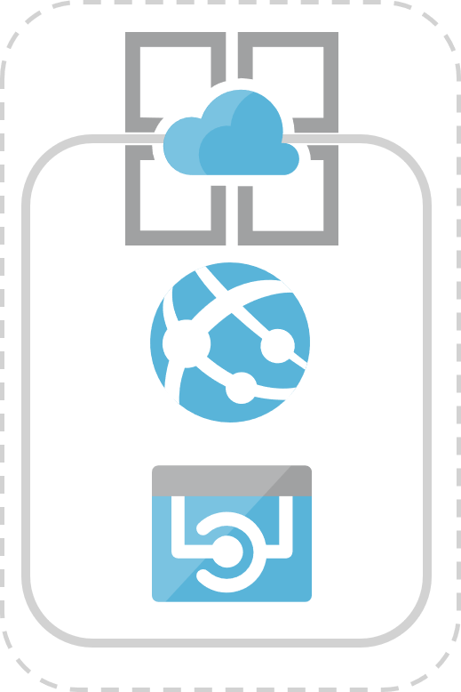
Preferred solution - 8
Achieving PCI Compliance
Web Apps certified for PCI Compliance
Restrict outbound traffic using Network Security Groups
Use Application Service Environment
Antivirus handled by Azure
Subnet
Restricted by NSG
Notes:
Keeping only the e-commerce website and handling of cardholder data in-scope for PCI, consider the following in your design:
Are Web Apps an option? Explain how using Web Apps you could address the PCI requirements you listed.
Web Apps are certified for PCI Compliance.
Need additional steps when dealing with cardholder data to meet PCI requirements of customer’s implementation.
Particularly with regards to restricting outbound traffic, use Network Security Groups applied to a subnet hosting Web App to restrict outbound traffic
Need to use Application Service Environment to achieve this
Antivirus requirement handled for you by Azure (since you do not have control or access to the underlying VM).

Slide 23
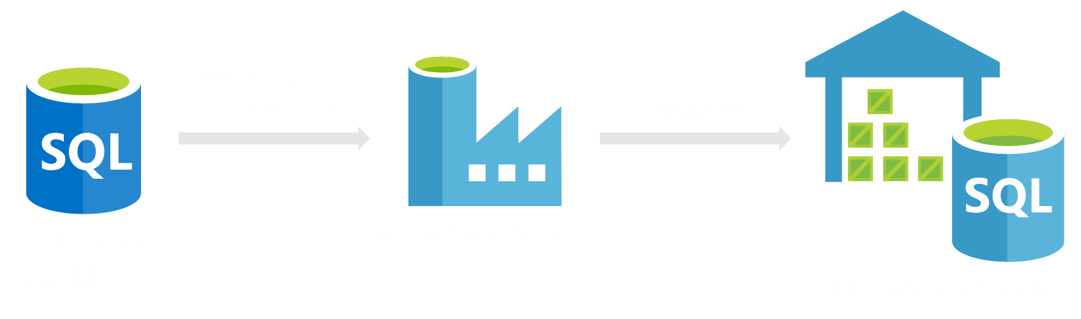
Preferred solution - 9
Data Warehouse
Azure Synapse Analytics
Notes:
How would you recommend Contoso implement their data warehouse?
Use Azure Synapse Analytics.
How would Contoso schedule nightly data transfers from their OLTP database to their data warehouse?
Provision Azure Data Factory, and use the Azure Data Factory Copy Wizard to setup a recurring copy from their SQL Database instance to existing tables in their SQL Data Warehouse, and enable Polybase for the copy to speed up the process.

Slide 24






Preferred solution - 10
Automated Deployments
E-commerce Website
Web App
Call Center Website
Web App
Offers Service
API App
Payments Service
API App
Code changes are pushed (or merged) into the master branch
GitHub Action workflow is triggered on
Push to the master branch. Automated
Deployment to Azure is achieved using
Azure actions from the GitHub marketplace.
PDF Receipt generation
Function App
Azure Function
Notes:
*Automated deployment*
1. How would you recommend Contoso implement their automated deployments?
They could use GitHub Actions to deploy code into Azure. GitHub Actions can authenticate to Azure via a Service Principal established in Active Directory, or via a Publish Profile downloaded from the Azure portal; both of which are stored in repository secrets so they are not visible or checked into source control. Multiple GitHub Actions are available in the GitHub Actions Marketplace to aid in implementing automated releases. For Contoso, they are interested in releasing web application and Azure Function applications, both of which are available in the marketplace.
2. How would Contoso implement the trigger for the automated deployment?
GitHub Actions are workflows defined using structured YML (pronounced YAML) files. In the workflow definition, Contoso can trigger their deployment workflow on push filtered by the master branch. Defined this way, the workflow will execute every time code is checked in to the master branch, including when a pull request is merged (the merge is considered a push of code).

Slide 25
Preferred objections handling
How can Azure Trust Center help with PCI compliance?
Can solution scale to meet customer demand, and allow secure access by call center and warehouse?
Can we conduct penetration testing in Azure?
Can we audit the Azure data center?
Notes:
It is not clear to us from the Azure Trust Center just how Azure helps our solution become PCI compliant.
The Azure Trust Center helps you to understand what Azure services have been certified for PCI compliance (for example, the services with which you could build a PCI compliant solution), but it does not describe how you build a PCI compliant solution on Azure.
To fully accomplish a PCI compliant solution, you must address the requirements of PCI according to how you are handling cardholder data and the scope of your services.
In many cases, Azure’s PCI compliance attestations will be enough to satisfy aspects of PCI compliance for your solution, but there are at minimum some items which you must handle as a part of building your application (for example, it is up to you to define and enforce secure password policies).
Can we provide a solution that scales to meet our public demand, but is also secure for use by our call center and warehouse?
Yes. Azure can provide a solution that is both scalable and secure.
Our PCI compliance requires us to have a quarterly audit and to conduct occasional penetration tests. Is this supported by Azure?
Yes. Although prior approval is not required, you may still formally document upcoming penetration testing engagements against Azure by filling out the Azure Service Penetration Testing Notification Form (https://portal.msrc.microsoft.com/en-us/engage/pentest)
Penetration testing must be conducted in accordance with our terms and conditions and comply with the Microsoft Cloud Unified Penetration Testing Rules of Engagement (https://technet.microsoft.com/mt784683)
Tests that would cause a Denial of Service (DoS) are prohibited.
Can we audit the Azure data center?
No.
Our independent audits and certifications are shared with customers in lieu of individual customer audits.
These certifications and attestations accurately represent how we obtain and meet our security and compliance objectives; and serve as a practical mechanism to validate our promises for all customers.
Allowing potentially thousands of customers to audit our services would not be a scalable practice and might compromise security and privacy.
Our independent third-party validation program includes audits that are conducted on an annual basis to provide verification of Azure security controls.

Slide 26

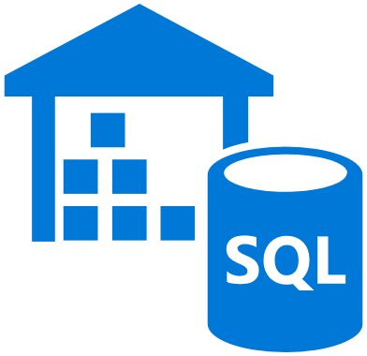
Preferred objections handling - 2
Can we leverage CloudTest in Azure?
What options are available for performance monitoring?
What is the impact of pausing Azure Data Warehouse on our data?
Can’t we use Azure SQL Database for our data warehouse?
Notes:
In the past, we have relied on SOASTA CloudTest to design and execute at scale our web load tests. In moving to Azure, are we still able to leverage CloudTest?
Yes.
Azure is a supported Cloud Provider for CloudTest, and your applications hosted in Azure can have load and performance tests conducted against them from SOASTA’s global network of cloud resources, while monitoring results in their big-data real-time streaming analytics platform.
Our previous infrastructure did not have great performance monitoring of our websites, what options would you recommend we investigate that would work with our Web Apps in Azure?
Web Apps on Azure include first-class support for both Microsoft Application Insights and NewRelic Application Performance Monitoring- both of which enable you to collect performance telemetry from your Web Apps as they are running.
You can view and analyze traces from both server-side and browser-side telemetry, diagnose errors and set alerts from within the Azure Portal.
Contoso can also leverage Log Analytics (a feature of Microsoft Operations Management Suite) by having the Application Insights logs or the Web App Diagnostic logs pushed to a Storage Account and then picked up and made searchable using the Custom Log. Alternately, they can also push their New Relic logs into Log Analytics, as well giving them a single pane of glass to do all of their monitoring thru Operations Management Suite.
We’ve heard that Azure’s data warehouse can be paused? Does that mean we must store all our data in Azure Storage first before we can pause the instances and risk losing our data?
SQL Data Warehouse uses storage into two ways, and both enable the data to exist even while the SQL DW instance is paused.
For data that is managed by SQL Data Warehouse (e.g., it is inserted directly into relational or columnar tables), it is stored in Azure Premium Storage.
For data supporting external tables in SQL DW, this data resides in Azure Standard Storage and is referenced via PolyBase, a component of SQL Data Warehouse.
We know it's possible to use Azure SQL Database as our data warehouse. What should we consider when deciding between this and Azure Synapse Analytics? It is true that Azure SQL Database can be used as a data warehouse. This is considered an SMP-based warehouse, or symmetric multiprocessing. Azure SQL Data Warehouse is classified as an MPP-based warehouse, or massively parallel processing. As a general rule, SMP-based warehouses are best suited for small to medium data sets (up to 4-100 TB), while MPP is often used for big data. The delineation between small/medium and big data partly has to do with your organization's definition and supporting infrastructure.
Beyond data sizes, the type of workload pattern is likely to be a greater determining factor. For example, complex queries may be too slow for an SMP solution, and require an MPP solution instead. MPP-based systems are likely to impose a performance penalty with small data sizes, due to the way jobs are distributed and consolidated across nodes. If your data sizes already exceed 1 TB and are expected to continually grow, consider selecting an MPP solution. However, if your data sizes are less than this, but your workloads are exceeding the available resources of your SMP solution, then MPP may be your best option as well. Given this, consider Azure SQL Data Warehouse for small and medium datasets, where the workload is compute and memory intensive.
Azure SQL Data Warehouse provides CSLA with a datastore that contains pre-aggregated data using column names that make sense to business users and analysts, a restructured schema to simplify data relationships, and consolidated tables. It also keeps historical data separate from the source transaction systems for performance reasons.

Slide 27
Customer quote
“I can sleep better an night knowing that our e-commerce solution is scalable to handle our biggest days, doesn’t sacrifice our required PCI compliance, and actually lowers our infrastructure burden.”
- Miles Strom, CEO of Contoso Sports League

